Slide 1
Employment Prediction DataSet

Slide 2
Dataset Overview
Objective: Predict employment status and analyze key factors affecting job opportunities.
Total Rows: 73,462 (Observations)
Total Columns: 15 (Features)
Target Variable: Employed (Employment Status)

Slide 3
Key Features in the Dataset
Age: Respondent’s age(<35,>35)
Gender:Gender identity(Male ,Female and Nonbinary )
Accessibility:Whether a candidate can easily access work opportunities (Technology, transport, or other necessary facilities)
Country:Country of residence
Mental Health :
Education & Experience:
Ed Level : : Highest level of education (e.g., Bachelor's, Master's, PhD)
Years Code :Total years of coding experience
Years CodePro: Years of professional coding experience

Slide 4
Employment Details:
Employment: Employment status of the candidates (example: currently working or unemployed)
Previous Salary:
Main Branch :Developer or Non Developer
Technology & Skills:
Have Worked With:
Language Worked With: Programming languages used (e.g., Python, Java)
Database Worked With: Databases used (e.g., MySQL, MongoDB)
Platform Worked With: Platforms used (e.g., Windows, Linux, AWS)
Computer Skills : Technical abilities of the candidates.

Slide 5
Data Preprocessing Techniques
Handling Outliers:
Used for Previous salary ,Years Code ,Years Code Pro and Computer Skills where extremely high values were observed.
Instead of removing outliers, extreme values were replaced with the 95th percentile (upper bound) and 5st percentile (lower bound).

Slide 6
Encoding Techniques & Scaling Technique Used
Label Encoding: Age , Gender, Accessibility, Mental Health,MainBranch
Frequency Encoding : Country
Ordinary Encoding: Ed Level
One Hot Encoding :Have Worked With
Scaling:
Min Max Scaler (Scaling to [0,1])
Applied to: Previous Salary, Computer Skills ,Years Code and Years Code Pro
X scaled ​=X-X min/(X max-X min)

Slide 7
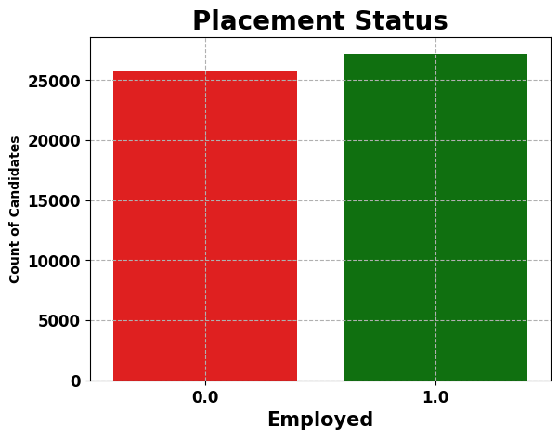
Count plot of Target column

Slide 8
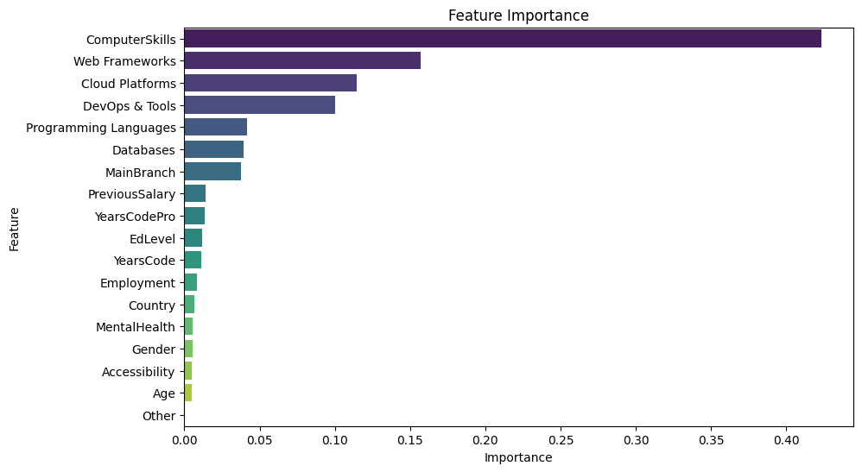
FEATURE IMPORTANCE

Slide 9
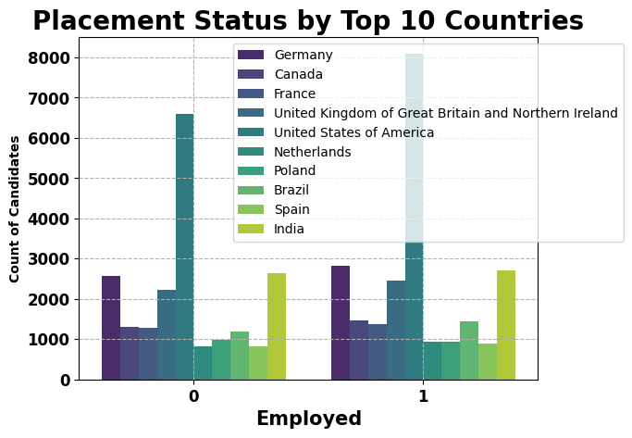

Slide 10
Machine Learning Models Used
Logistic Regression
Random Forest Classifier
Decision Tree Classifier
XG Boost Classifier (Final Model):
Best performance in terms of accuracy and generalization

Slide 11
Summary of Findings
Factors like education level, years of experience, and country and PreviousSalary
Significantly impact employment status.
Candidates with higher ComputerSkills and higher education tend to have a
higher probability of employment.
Certain programming languages and technologies are in higher demand than others.

